Slide 1

SSD-Statewide Space Planning
presents
SPACE…
Planning and Modular Furniture Standards

Slide 2


While we install statewide, we do have our limitations…
Here’s how it works

Slide 3
Expectations – these are things we can address…
We provide all modular furniture, including related design work and installation. This work is managed by Statewide Space Planning and funded by our budget.
Our section can also assist in selecting paint, carpet and artwork, and consult on lighting design. SSD will fund carpet, paint and lighting changes, if they are justifiable.
Allow 90-120 days for delivery of TCI modular furniture, after approval of design.
A $75/hour mileage fee for the delivery will be charged to the district by the TCI installers.
A design of the proposed space usually takes about 14 days to complete after the initial site evaluation (or after a completed Field Measure Form has been returned to the designer).

Slide 5
Field Verify – we need your help.

Slide 6
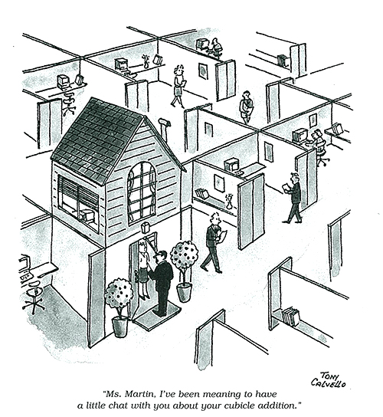
About our standards…

Slide 7
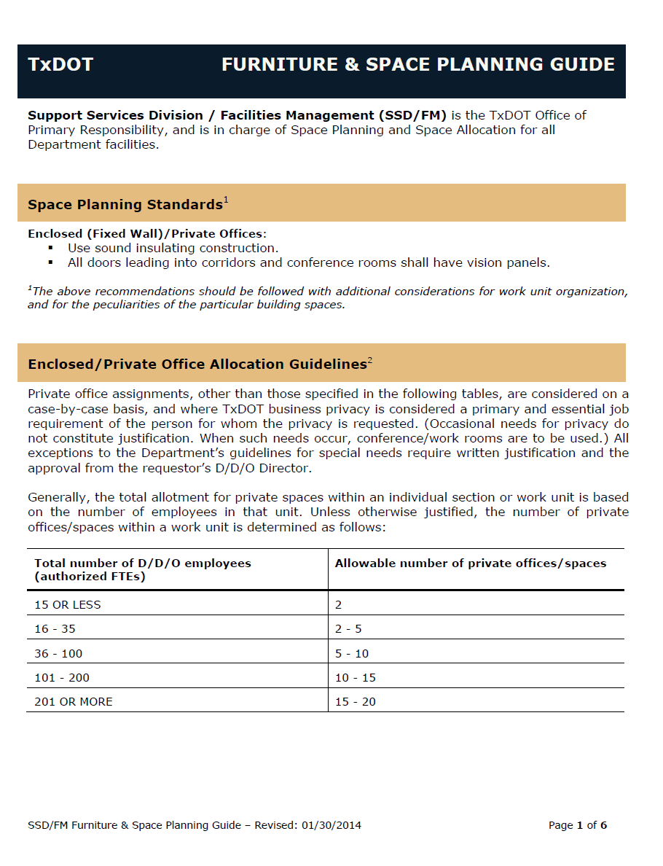
Furniture & Space Planning Guide
The Guide outlines our standards for:
Enclosed/Private Offices
Modular Furniture Components
Standard Cubicle Layouts
Furniture Finishes Standards
Conference Rooms and other support spaces

Slide 8


Ready for a break?

